Slide 1
College Database Management System
Presented By:
Madhav Chandok
1902160130023

Slide 2
Objective of My Project
Data becomes a huge trouble in this modern era and management of data is quite a big trouble.
Storing and searching of information is very fast in computers as compared to manual form.

Slide 3
What is Database?
A database is an organized collection of data, so that it can be easily accessed and managed.
We can organize data into table format consisting of rows, columns, and index to make it easier to find relevant information.
There are various databases available such as MySQL, Oracle, Microsoft Access and so on.

Slide 4
About My Project
There are many approaches to achieve my goal but I choose something different to learn new.
College Database Management System application is purely developed in C language environment.
The whole code is compiled in Code::Blocks GCC Compiler.

Slide 5
Introduction to College Database Management System
As discussed earlier CDMS is a database management system.
It is a multi user administration application using which they can store information of students and faculty members.
In my project, admin can easily add, remove, search for the information regarding students and faculty members.
1 / 2

Slide 6
Continued….
The whole program is very dynamic.
The application is very user friendly and easy to use.
Application are based on the concept of File Handling of C language.
Application is fully secured and follows the general principle of Cyber Security:
Confidentiality, Availability, Integrity.
2 / 2

Slide 7
Technological Description

Slide 8
What is C language?
C is a general purpose language which is very closely associated with UNIX for which it was developed in Bell Laboratories.
Most of the programs of UNIX are written and run with the help of ‘C’.
In 1972, Dennis Ritchie a Bell Laboratories wrote C Language which caused a revolution in computing world.

Slide 9
Why Name ‘C’ was given to this language?
Many of the ideas of C language were derived and taken from ‘B’ language.
BCPL and CPL are previous versions of ‘B’ language.
As many features came from B it was named as ‘C’.

Slide 10
Description of C language
C is a structured programming language.
C supports functions that enables easy maintainability of code, by breaking large file into smaller modules.
Comments in C provides easy readability.
C programs are built from the combination of variable, functions, statements, and expressions.

Slide 11
Structure of a C Program

Slide 12
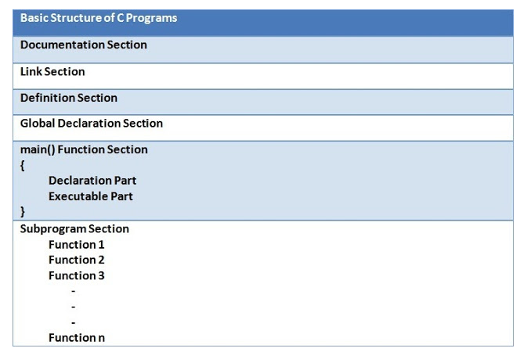
A basic C program consists of six basic main sections.
Fig: Structure of C Program [1]

Slide 13
Documentation Section
This section consists of comment lines which include the name of programmer, the author and other details like time and date of writing of program.
Documentation section helps anyone to get an overview of the program.

Slide 14
Link Section
stdio.h
Input/Output functions
conio.h
Console Input/Output functions
stdlib.h
General utility functions
math.h
Mathematics functions
string.h
String functions
ctype.h
Character handling functions
time.h
Date and time functions
float.h
Limits of float types
limits.h
Size of basic types
The link section consists of the header files of the functions that are used in the program.
It provides instructions to the compiler to link functions from the system library.

Slide 15
Definition Section
All the symbolic constants are written in definition section.
Macros are known as symbolic constants.
Example: #define pie 3.14, #define a 10

Slide 16
Global Declaration Section
The global variable that can be used anywhere in the program are declared in global declaration section.
This section also declares the user defined functions.

Slide 17
main() Function Section
It is necessary to have one main() function section in every C program.
This section contains two parts: declaration and executable part.
The declaration part declares all the variables that are use in execution part.
These two parts must be written in between the opening braces and ends at closing braces.

Slide 18
Subprogram Section
The Subprogram section contains all the user defined functions that are used to perform a specific task.
These user defined functions are called in the main() function.

Slide 19
Concepts Used in Project

Slide 20
C Pointers
The pointers is a variable which stores the address of another variable.
The pointer in C language can be declared using * (asterisk symbol).
It is also known as in-directional pointer used to dereference a pointer.

Slide 21
Usage of Pointers
Dynamic memory allocation: In C language, we can dynamically allocate memory using malloc() and calloc() functions where the pointer in used.
Arrays, Function and Structures: Pointers in C language are widely used in arrays, functions and structures. It reduces the code and improves the performance.

Slide 22
File Handling in C Language
File Handling in C enables us to create, update, read and delete the files stored on the local file system through out C program.
The following operations can be performed on a file:
Creation of the new file.
Opening an existing file.
Reading from the file.
Writing to the file..
Deleting the file.

Slide 23
Functions in File Handling
S.No | Function | Description
1 | fopen() | Opens new or existing file.
2 | fprintf() | Write data into the file.
3 | fscanf() | Reads data from the file.
4 | fputc() | Writes a character into the file.
5 | fgetc() | Reads a character from the file.
6 | fclose() | Closes the file.
7 | fseek() | Sets the pointer to the given position.
8 | fputw() | Writes an integer to file.
9 | fgetw() | Reads an integer from file.
10 | ftell() | Returns current position.
11 | rewind() | Sets the file pointer to the beginning of the file.

Slide 24
C Structure
Structure in C is a user-defined data type that enables us to store the collection of different data types.
Each element of a structure is called a member.
Structures can stimulate the use of classes and templates as it can store various information.

Slide 25
Methodology

Slide 26
User Login Screen
Application has multi-user login system which will help in protecting it from unauthorized access.
Default Username: IIMTCOE
Default Password: 0216
Admin can add, remove, and update the username at any time easily.
This will ensures the confidentiality of the program.

Slide 27
Menu Screen
This screen shows all the functionalities that the program can do.
It includes functions such as addition, removal, updating, search, print the information of students and faculty members present in the database.

Slide 28
ScreenShots

Slide 29
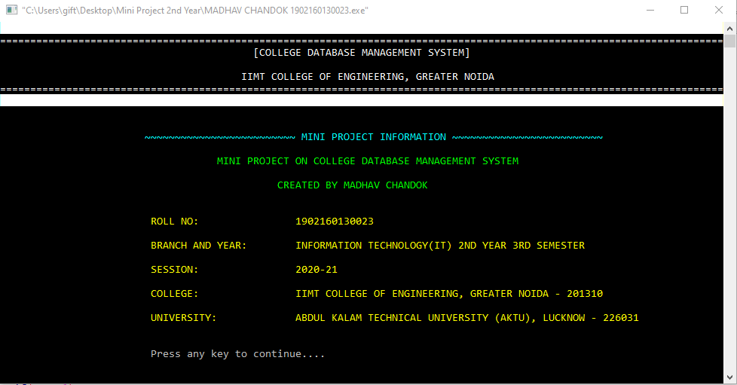
Fig: Information Screen.

Slide 30
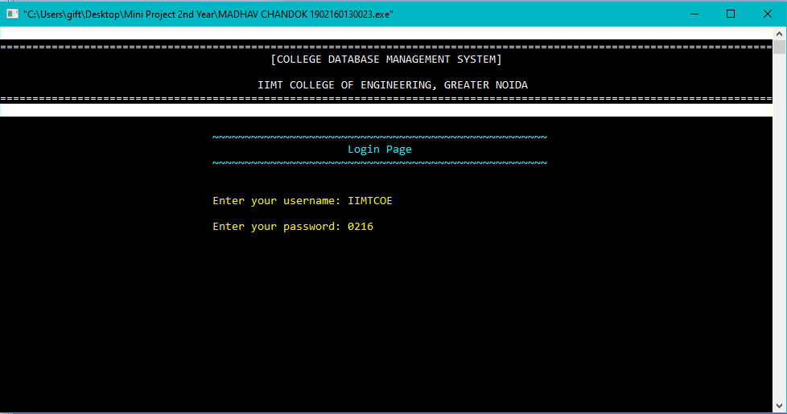
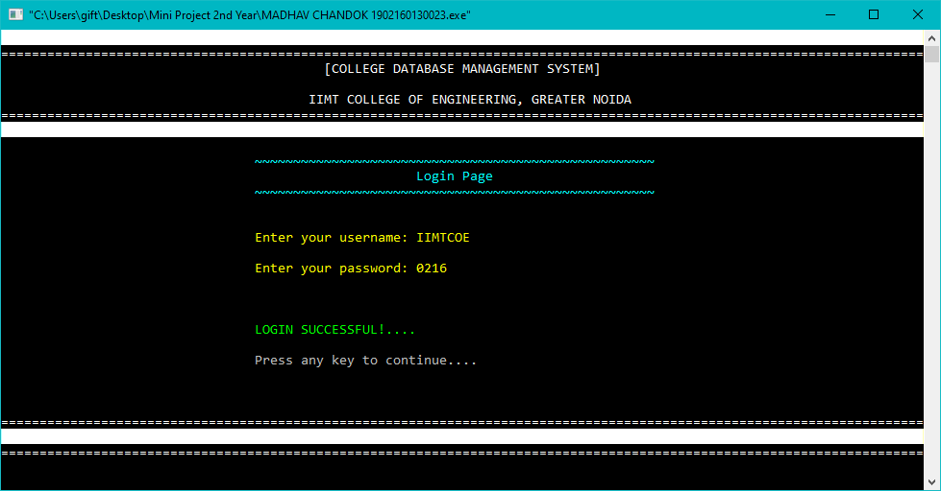
Fig: Multi User Login System.

Slide 31
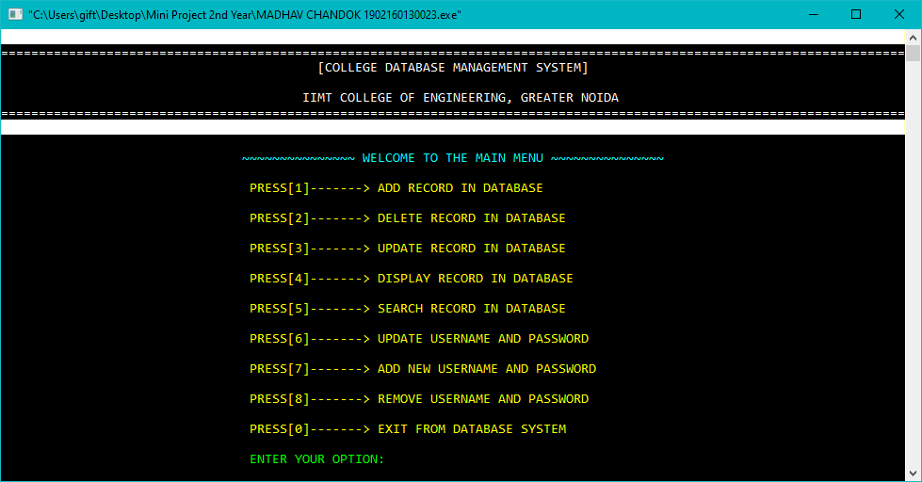
Fig: Main Menu.

Slide 32
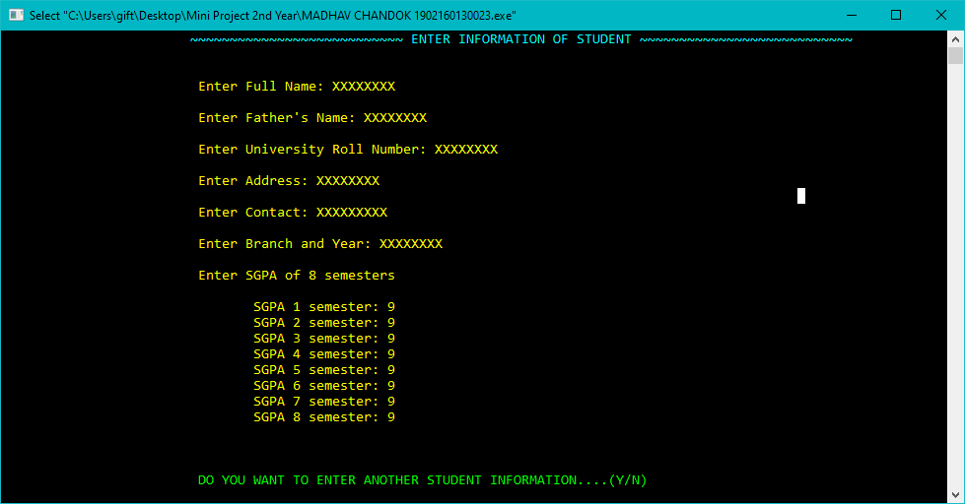
Fig: Add Student Record.

Slide 33
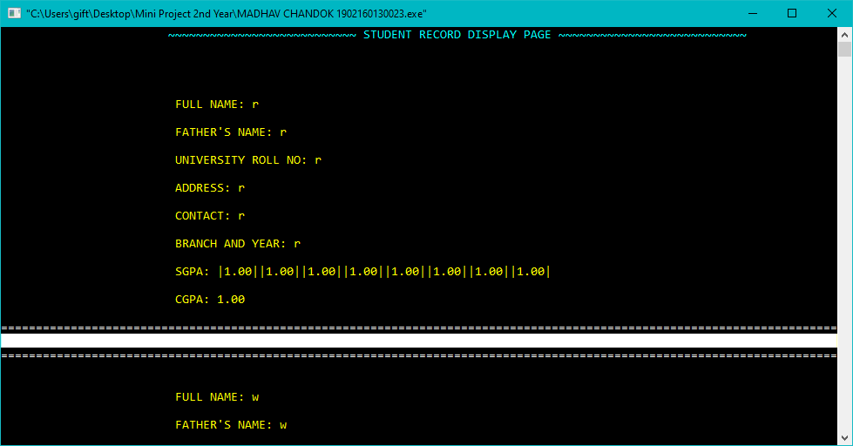
Fig: Show all records present in Database.

Slide 34
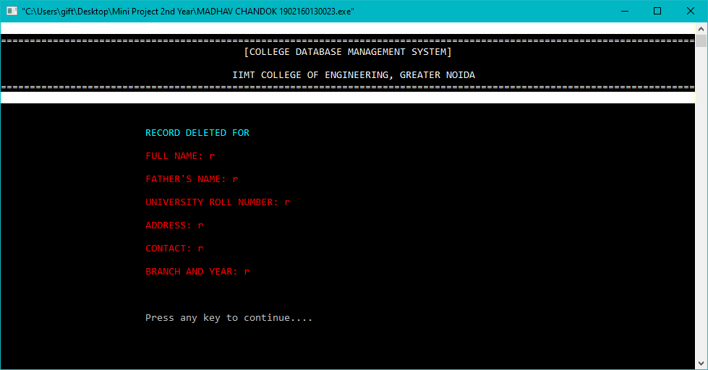
Fig: Record Deletion from Database.

Slide 35
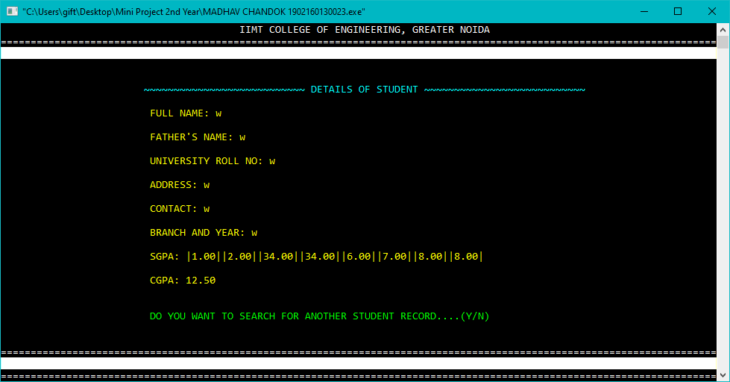
Fig: Search details in Database.

Slide 36
Source Code
https://drive.google.com/file/d/1v_vTuJNPIpw1IgBauZspDH9xDX bXLyA7/view?usp=sharing
Project Files
https://drive.google.com/file/d/1t5pIe1vmOoJyfR44ODuxlSYtd8ZSinMG/view?usp=sharing
https://drive.google.com/file/d/1hLPVUvQU2wacrfr-z7q06h2xiZASkv9P/view?usp=sharing

Slide 37
Thank You for listening patiently..

